Slide 1


Predicting the news popularity in multiple social media platforms.
Team Member’s
Mentor Name
Publish Date
Shivangi Patel
Ravi Gohil
Harsh Thakkar
Kirti Pandey
Rohit Bhadauriya
20-10-2022

Slide 2



Economy
Microsoft
Obama
Palestine

Slide 3

ML(Machine Learning) Steps
Data overview
Data cleaning
Null value handling
EDA (Exploratory Data Analysis)
Univariant
Bivariant
Multivariant
Feature Engineering
Create leaner regression Base model
VIF (Variance Inflation Factor)
Convert the target for classification
Applicated Under sampling
Create Base Model
Model Tuning
Cross validation ( grid search CV )
Applied Oversampling
Base Model create
Hyperparameter Tuning
Final model

Slide 4

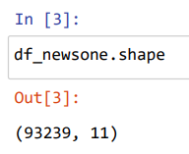
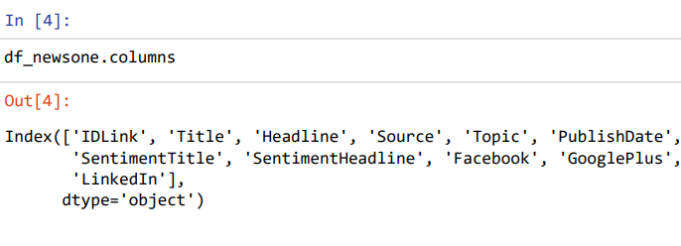
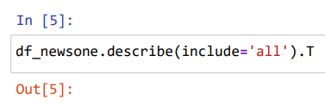

1) Data Overview
Data that has been interpreted and manipulated and has now some meaningful inference for the users.
1. Shape of the data
3. Describe the dataset
2. Check the columns(features)
4. Check for data types

Slide 5

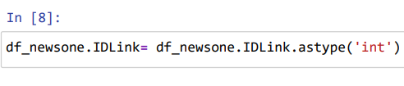
2) Data cleaning
Data Cleaning machine learning is the method of identifying the incomplete, wrong, unnecessary, incorrect, or missing part of the data and then changing, replacing, or removing them according to the specific requirement.
Change a data type

Slide 6

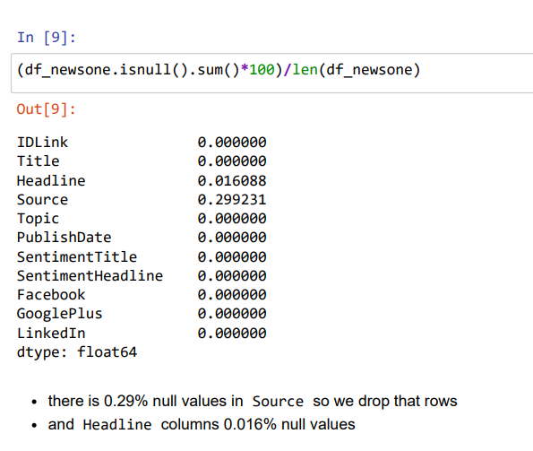
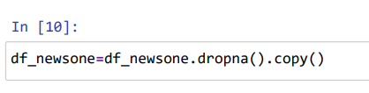
3) Null value handling
Null values can take on many different forms in machine learning, such as missing data, invalid data, or incorrect data.
1. Check percentage
of null values
Nan
Nan
Nan
Nan
Nan
Nan
Nan
Nan
Nan
Nan
Nan
Nan
Nan
Nan
Nan
Nan
Nan
Nan
Nan
Nan
Nan
Nan
Nan
Nan
2. Deal with null
values

Slide 7

4) EDA (Exploratory Data Analysis)
A method for summarizing data, identifying patterns and relationships, and detecting outliers is exploratory data analysis. This type of data analysis is most often used when the data set is large or complex, and it can help with data comprehension.

Slide 8
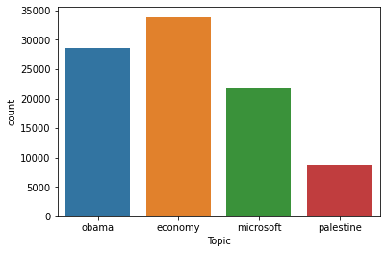
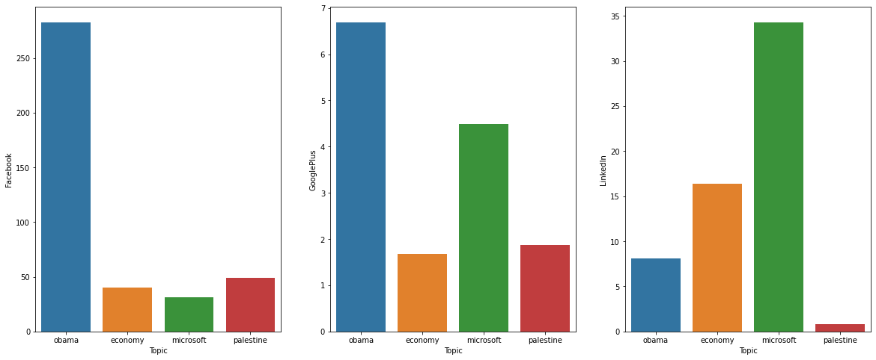
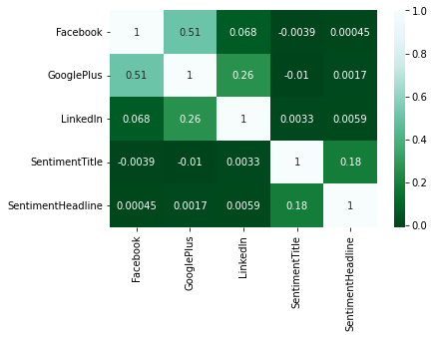
Univariate
Bivariate
Multivariate
Univariate function optimization involves finding the input to a function that results in the optimal output from an objective function. This is a common procedure in machine learning when fitting a model with one parameter or tuning a model that has a single hyperparameter.
Two variables are involved in bivariate data. Bivariate analysis is concerned with causes and relationships, and the goal is to determine the relationship between the two variables.
Multivariate classification is a machine learning technique used to predict the class of an observation based on multiple features or variables. It is a form of supervised learning, meaning that it relies on labeled training data to learn the relationship between the features and the classes.

Slide 9

4.1) EDA Summary
. Through our analysis we could figure that amongst all the four news topics, news items related to Economy were most popular on social media.
2. Secondly, we figured that Facebook has higher reach as compared to GooglePlus and LinkedIn.
3. Next we found out that the news items related to the topic Obama trended more on Facebook and Google plus. Also, the news items related to Microsoft trended more on LinkedIn.
4. In multivariate analysis we could conclude that 51% of Facebook news are also shared on Google plus and vice-versa.

Slide 10

5) Feature Engineering
Feature engineering or feature extraction or feature discovery is the process of using domain knowledge to extract features from raw data.
1.Featureselction
2.Feature extraction
3.Encoding And Scaling

Slide 11
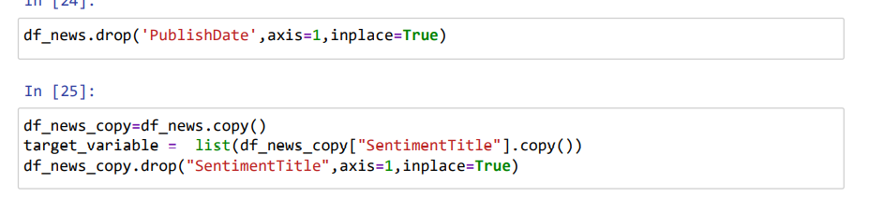
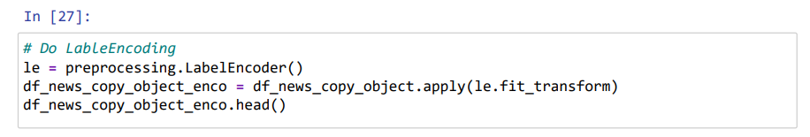
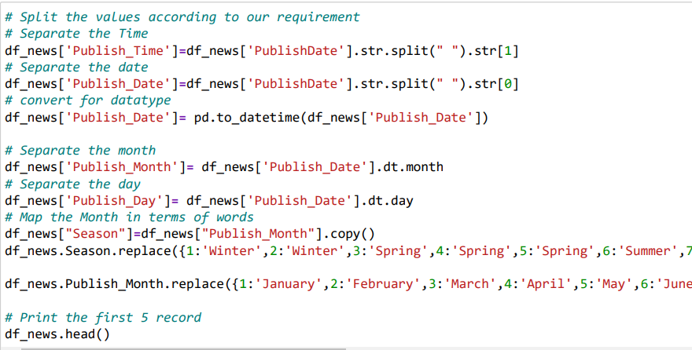
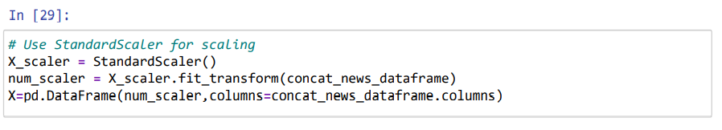
Feature selection
Feature extraction
Encoding And Scaling
In feature selection we select only most relevant column over the dataset .
Feature extraction is very different from Feature selection: the former consists in transforming arbitrary data, such as text or images, into numerical features usable for machine learning.
Encoding and scaling is technique which use data is ready for machine model . And model is work on good manner .

Slide 12

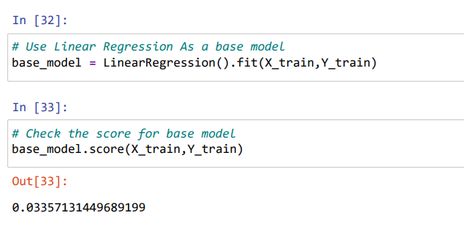
6) leaner regression Base model
Linear Regression is a machine learning algorithm based on supervised learning. It performs a regression task. Regression models a target prediction value based on independent variables. It is mostly used for finding out the relationship between variables and forecasting.

Slide 13

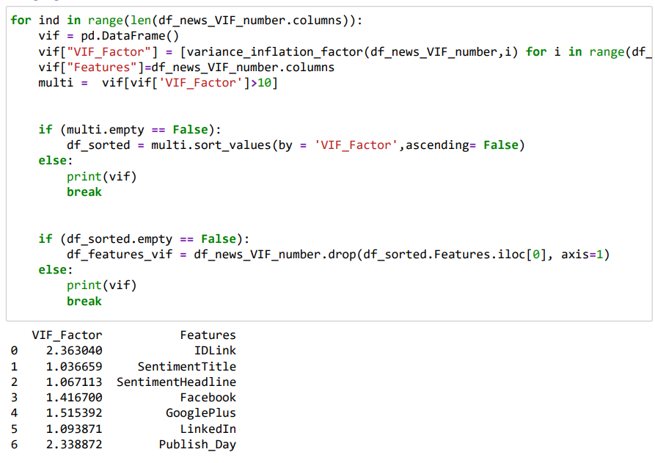
7) VIF (Variance Inflation Factor)
A variance inflation factor (VIF) is a measure of the amount of multicollinearity in regression analysis. Multicollinearity exists when there is a correlation between multiple independent variables in a multiple regression model. This can adversely affect the regression results.

Slide 14

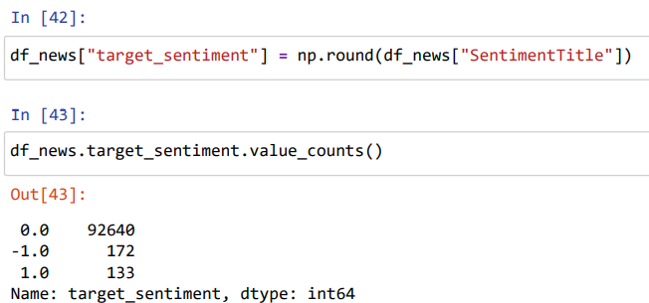
8) Convert the target for classification
We are use np.round function and we get three category
1,-1,0
-1 not influence by people.
0 moderate influence by people.
1 highly influence by people.

Slide 15

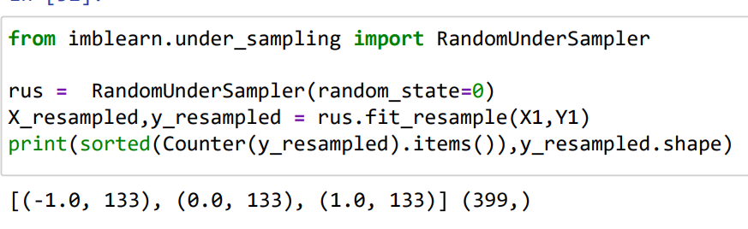
9) Applicated Under sampling
If our data is imbalance at that time we perform over sampling and under sampling .
Here our target variable is imbalance so we apply under sampling on target variable column . For balancing a categorical values.

Slide 16
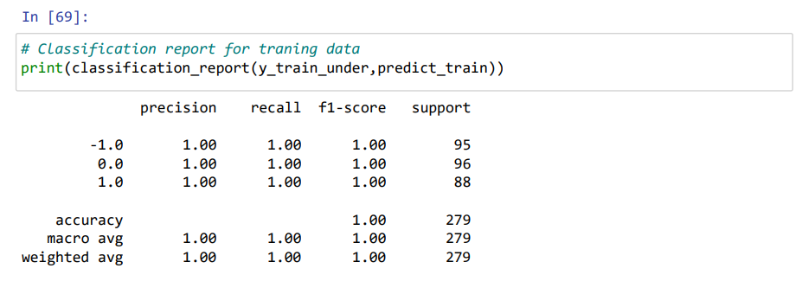
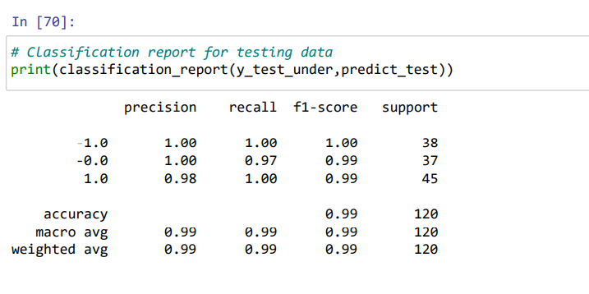
10) Apply Decision Tree
First under sample based model :

Slide 17

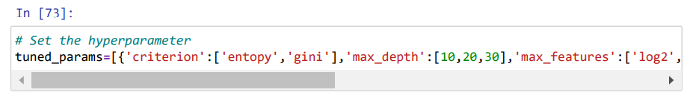
Model tuning :
The goal of model tuning is to optimize the values of Hyperparameters. Major characteristics of hyperparameters are – These are tuned They are external values These are defined by a user These aren’t part of a trained model. Hyperparameter optimization is another term for model tuning.

Slide 18

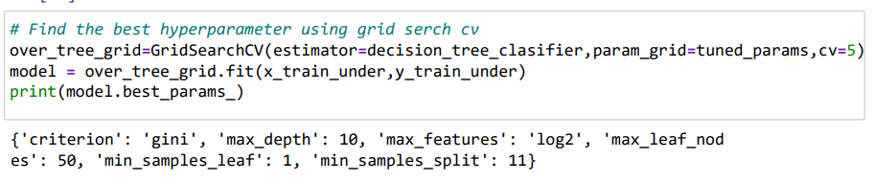
Cross validation ( grid search CV )
GridSearchCV is a technique to search through the best parameter values from the given set of the grid of parameters .

Slide 19
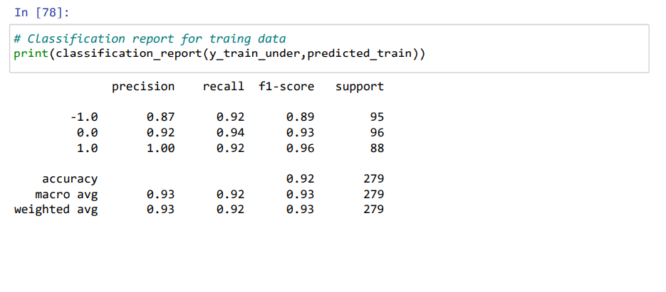
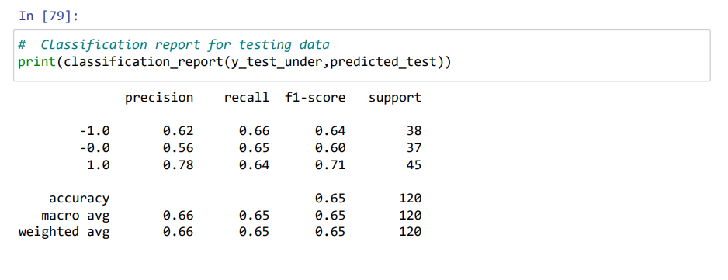
Gride search cv is return good hyperparameter . And that parameter we use for creating new model over the under sample data set .
As we can see model is overfitted, the reason is taring accuracy is 92% and testing accuracy 65%

Slide 20
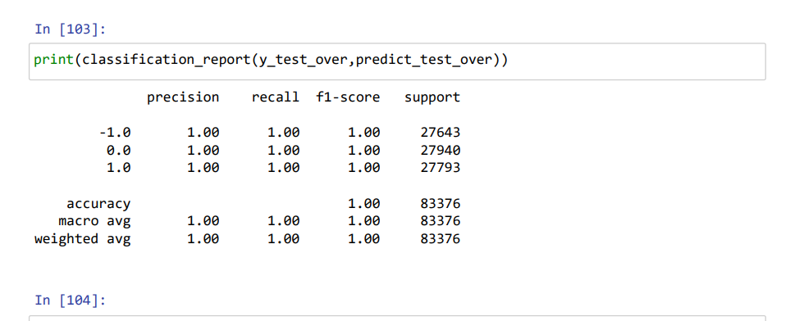
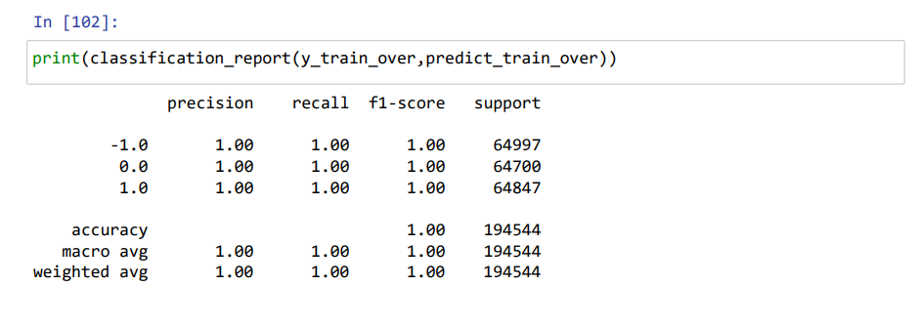
We also do same process for over sampling
But In over sampling data set is work good with Decision Tree model
Final Model
As we can see here oversampling concept good fit for the data That proven by seen the accuracy of taring and testing.

Slide 21

Thank you !

